Slide 1

Introduction to serverless computing with Azure Functions
Piyush Vaishya
Associate Data Engineer

Slide 2
The “evolution” of application platforms
Notes:
All good things begin with a story.
So before I talk to you about serverless, I wanted to discuss some history of how apps have been built through the years and how that has led us to the computing options we have today.
Buy your own hardware and software
Run it in your own data-centers
Deal with a multitude of questions
# of servers
Physical security
Hardware failure
Software patching
Backup
Essentially a lot of questions, not all of which might be directly related to running your business. For example, if you are running an insurance company, you want to spend your time growing and innovating in the insurance domain, not worrying about how to handle servers.

Slide 3
What is the right size of
servers for my business needs?
How do I deploy new code to my server?
What media should I
use to keep backup?
What happens in case of
server hardware failure?
Which packages should be on my server?
What size of servers
should I buy?
Who monitors
my App?
How often should I backup my server?
How can I scale my app?
How can I increase server utilization?
Who has physical
access to my servers?
Which OS should I use?
Do I need secondary network connection?
Are my server in a
secure location?
What happens if the
power goes out?
Who monitors
my Servers?
Do I need a UPS?
What storage I need to use?
How many servers
do I need?
How can I dynamically configure my app?
It takes how long to provision a new server?
How often should
I patch my servers?
On-Premises
The “evolution” of application platforms
Notes:
All good things begin with a story.
So before I talk to you about serverless, I wanted to discuss some history of how apps have been built through the years and how that has led us to the computing options we have today.
Buy your own hardware and software
Run it in your own data-centers
Deal with a multitude of questions
# of servers
Physical security
Hardware failure
Software patching
Backup
Essentially a lot of questions, not all of which might be directly related to running your business. For example, if you are running an insurance company, you want to spend your time growing and innovating in the insurance domain, not worrying about how to handle servers.

Slide 4
What is the right size of servers for my business needs?
How can I increase server utilization?
How many servers do I need?
How can I scale my app?
How often should I patch my servers?
How do I deploy new code to my server?
How often should I backup my server?
Which OS should I use?
Which packages should be on my server?
Who monitors my App?
On-Premises
IaaS
The “evolution” of application platforms
Notes:
Along came the cloud, and provided some relief from some of those questions.
IaaS in the cloud, allowed you to forget about managing all that physical hardware. Instead of hosting it yourself, you could now utilize servers hosted by someone else. While the worries around managing physical infrastructure are gone, there are a number of questions that still need to thought about:
How many virtual machines do I need?
How many would I need in future when my usage grows?
How to handle updating the servers for the latest security patches
How to think about deploying my code and the various dependencies, such as application runtimes, to the server
Who monitors my apps and so on
This means that you still haven’t reached that ideal state where you could focus purely on your business and its problems.

Slide 5
What is the right size of “servers” for my business needs?
How can I increase “server” utilization?
How many “servers” do I need?
How can I scale my app?
On-Premises
IaaS
PaaS
The “evolution” of application platforms
Notes:
Well, the cloud continue to help with that problem and with the advent of PaaS, there was even more simplification. PaaS allows you to just worry about your app, and let the cloud vendor take care of not only the physical hardware, but also the ongoing management of the operating environment like Operating Systems, Virtual Machines or Containers, as well as the various application runtimes, whether it is Java Runtime, .NET, Node.js, and so on.
You are not completely free from thinking about servers however, since you still have to worry about how to scale your app and accordingly specify the number and size of the various compute resources your apps would need at various times.

Slide 6
How do I architect my app?
Serverless, the platform for next gen apps
On-Premises
IaaS
PaaS
Serverless
The “evolution” of application platforms
Notes:
The latest in this series of evolution is Serverless – which further abstracts the underlying infrastructure from you, and allows you to focus only on a single question – how are you going to build your app to achieve the best results for your business, or whatever it is that you are trying to do with your apps.
Whether it is the code to delight your customers through a great experience, or the logic to communicate securely with a business partner, that is where most organization want to spend their creative energies on.
And serverless allows you to do just that, focus on your code and forget about the infrastructure.
This is why we believe it is the platform for next generation of apps.
Now before we jump into explaining the benefits of serverless, let’s call out what it’s not. It’s not the total lack of servers, that would a bit difficult. Instead, it’s a system where you don’t have to think about Servers at all, so for you, they are invisible.

Slide 7
What is “serverless”
Abstraction of servers
Event-driven scale
Sub-second billing
Notes:
Abstraction of servers, infrastructure and configuration of operating system
Event-driven scale
Sub-second billing
Stateless

Slide 8
Benefits of “serverless”
Micro-pricing
Ease of scale
Manage less
Notes:
“Pinnacle of PaaS compute”
Not just hardware “servers”, but software servers are also managed for you
Focus on business logic, not solving technical problems not core to business
Lower effort to get started makes it easier to experiment (bots, etc.)

Slide 9
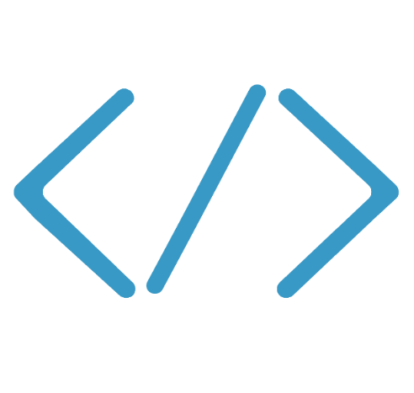

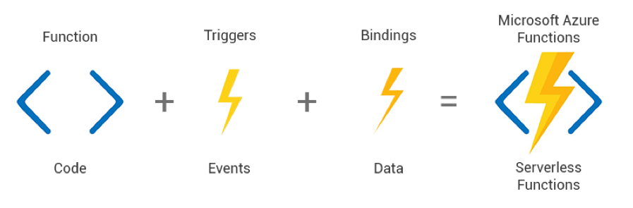
Azure Functions
Code
Azure Functions
Events & Data
Azure Functions is a solution for easily running small pieces of code, or "functions," in the cloud
Functions can make development even more productive
Azure Functions develop serverless applications on Microsoft Azure
Choose from a variety of programming languages
Notes:
We already saw how Functions provide an experience of responding to events through code that in turn processes data that could be coming from or headed to any number of services. Some of the key highlights are:
Ability to build, test and debug your Functions code locally on your own machine before your code is even deployed to the cloud. This is a massive productivity benefit while building cloud applications and something Azure provides through rich integration with a world class developer tool like Visual Studio
Secondly, unique features like triggers and bindings that make it super easy to setup event-driven architectures and simplify communication with data sources
Thirdly, we support a number of programming languages. In the demo we saw an example with C#. But we also support Node.js, F#, Python and even bash so you can pick the language of your choice to write serverless functions with
Lastly, Functions support concepts such as Continuous deployment, which makes it super easy to integrate them into your existing DevOps pipelines.

Slide 10






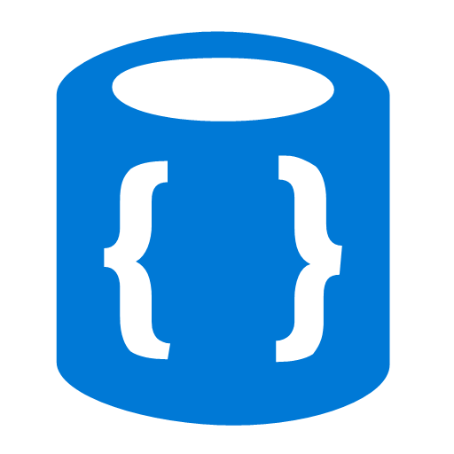


Azure Functions
Events
Code
Outputs
React to timers, HTTP, or events from your favorite Azure services, with more on the way
Author functions in C#, F#, Node.JS, Java, and more
Send results to an ever-growing collection of services

Slide 11
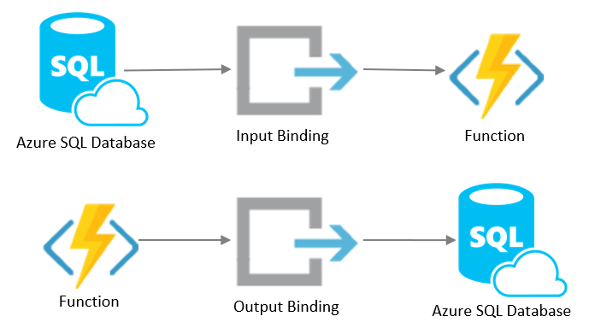


Binding
Binding is used to connect another resource to the function
Input Binding & Output Binding
Data from bindings is provided to the function as parameters
Triggers
Blob storage
IoT Hub
Table storage
Mobile Apps
Cosmos DB
HTTP Trigger
Timer Trigger
Blob Trigger
Mobile Apps
CosmosDB Trigger
Azure Function Example
Triggers are what cause a function to run and defines how a function is invoked
A function must have exactly one trigger
Notes:
We already saw how Functions provide an experience of responding to events through code that in turn processes data that could be coming from or headed to any number of services. Some of the key highlights are:
Ability to build, test and debug your Functions code locally on your own machine before your code is even deployed to the cloud. This is a massive productivity benefit while building cloud applications and something Azure provides through rich integration with a world class developer tool like Visual Studio
Secondly, unique features like triggers and bindings that make it super easy to setup event-driven architectures and simplify communication with data sources
Thirdly, we support a number of programming languages. In the demo we saw an example with C#. But we also support Node.js, F#, Python and even bash so you can pick the language of your choice to write serverless functions with
Lastly, Functions support concepts such as Continuous deployment, which makes it super easy to integrate them into your existing DevOps pipelines.

Slide 12
Features of Azure Function
Choice of language
Write functions using your choice of C#, Java, Javascript, Python, and other languages
Pay-per-use pricing model
Pay only for the time spent running your code
Integrated security
Protect HTTP-triggered functions with OAuth providers such Facebook, Google, Twitter, and Microsoft Account
Local Development
Ability to build, test and debug your Functions code locally on your own machine before your code is even deployed to the cloud
Notes:
So what kind of apps and scenarios can be built using serverless technologies? This is not a trick question because I have already given you the answer.
Anything where there is need to run some code or logic in response to an event. You will notice that this is a very broad definition and covers a vast array of scenarios. So let me provide some examples:
Real-time stream processing: IoT devices sending data that needs to be analyzed, enriched and archived somewhere. This is best done using serverless functions which can be spun up on demand, because you don’t know when the data is going to come in and how much data is going to come in. So, you don’t necessarily want to build your own infrastructure for peak capacity.
Almost every organization needs to run some regular tasks like de-duplication of database entries at the end of every day or collecting logs at the end of every week. Such tasks that need to be run only at specific times and only for a few seconds each time, don’t call for dedicated infrastructure. They are best left to serverless solutions.
Building backends for your mobile, IoT or even web apps is also a popular use-case for serverless architectures: In this diagram you see a mobile app sending an image to a function which stores it in Azure Storage. This action triggers another function which creates multiples thumbnails out of the original image. Being able to perform these action in a serverless manner, takes away the burden of the mobile developer from worrying about the backend.
Bots are all the new rage: Automated response systems receiving a customer request is an event. Building intelligent bots for such scenarios using serverless technology is again a great example where the focus needs to be on logic instead of infrastructure.
These are only some of the many examples which fit well with serverless.

Slide 13
Scenarios for Azure Function
Anything that needs to respond to events
Real-time stream processing
Timer-based processing
Millions of devices feed into Stream Analytics
Transform to structured data
Store data in SQL DB
Every 15 minutes
Find and clean invalid data
Clean table
Backends (Mobile/IoT/Web)
Real-time bot messaging
?
...
Photo taken and WebHook called
Stores in blob storage
Produces scaled images
Message sent to Chatbot
Chatbot sends
response
Cortana Analytics answers questions
Notes:
So what kind of apps and scenarios can be built using serverless technologies? This is not a trick question because I have already given you the answer.
Anything where there is need to run some code or logic in response to an event. You will notice that this is a very broad definition and covers a vast array of scenarios. So let me provide some examples:
Real-time stream processing: IoT devices sending data that needs to be analyzed, enriched and archived somewhere. This is best done using serverless functions which can be spun up on demand, because you don’t know when the data is going to come in and how much data is going to come in. So, you don’t necessarily want to build your own infrastructure for peak capacity.
Almost every organization needs to run some regular tasks like de-duplication of database entries at the end of every day or collecting logs at the end of every week. Such tasks that need to be run only at specific times and only for a few seconds each time, don’t call for dedicated infrastructure. They are best left to serverless solutions.
Building backends for your mobile, IoT or even web apps is also a popular use-case for serverless architectures: In this diagram you see a mobile app sending an image to a function which stores it in Azure Storage. This action triggers another function which creates multiples thumbnails out of the original image. Being able to perform these action in a serverless manner, takes away the burden of the mobile developer from worrying about the backend.
Bots are all the new rage: Automated response systems receiving a customer request is an event. Building intelligent bots for such scenarios using serverless technology is again a great example where the focus needs to be on logic instead of infrastructure.
These are only some of the many examples which fit well with serverless.

Slide 14
Demo
Functions
Notes:
Demo Thiago did in Brazil:
Pre-create a Function App on the portal and open it in the portal
How to create an Azure Function in four different ways
Call out that the host used by all four is the Functions Core Tools, which is the same code running on Azure to host the functions
Type one: from the portal
Create a new HTTP Triggered C# or Node function in the pre-created Function App
Explain the function app is where you put functions that form the same microservice, and share the same
Show all the different templates you have the option to choose, with different triggers and languages
Once the HTTP Triggered C# or Node function is created, explain the template code quickly, get the function URL from the “Get Function URL” link
Use browser to call it, show the message asking for a name
Add ?name=<your name> to the query string and call it again and show it says “Hello <your name>”
Type two: from the Azure Functions Core Tools CLI
Pre-install the functions core tools (v2 if you’re using a Mac) https://docs.microsoft.com/en-us/azure/azure-functions/functions-run-local#install-the-azure-functions-core-tools
Create a new folder
Create a new local function app with “func init”
List the files created and explain these are related to the Function App that you explained in the portal
Create a new local function with “func new”, choose either C# or Node, and choose HTTP Trigger
Start the function locally with “func host start”
Get the URL from the function in the logs in the cli and call it from a browser, curl or from Postman
Type three: from Visual Studio Code. Install the Azure Functions extension to Visual Studio Code
Use the Visual Studio Code command (Command P or Control Shift P) and enter > Functions. You should have an option to create a new Functions Project
Create a new project, choose the same templates as before
Use the command again and create a new Function in the Functions Project
Go to the Debug tools section of Visual Studio Code and click the play button to “Attach to Azure Functions”
This should start the CLI with the host, and attach to the process
Put a breakpoint in the code
Copy the URL from the function
Go to browser/curl/postman and make a call
Show that the breakpoint is hit
Type four: Visual Studio
Make sure you have the latest Visual Studio 2017, and with the latest Azure Functions and Web Jobs Tools extension https://marketplace.visualstudio.com/items?itemName=VisualStudioWebandAzureTools.AzureFunctionsandWebJobsTools
Create a new function app with File -> New -> Azure Function
Select HTTP Trigger
Explain that this is a compiled class library, and not script, so they can bring in all their .NET Full Framework or .NET Core dependencies into the project
Put a breakpoint in the code
Start debugging
Show that the func runtime starts too
Hit the site URL and show that the breakpoint was hit
Finally, mention that great support for Visual Studio for Mac is coming (the current edition is Mono based)

Slide 15
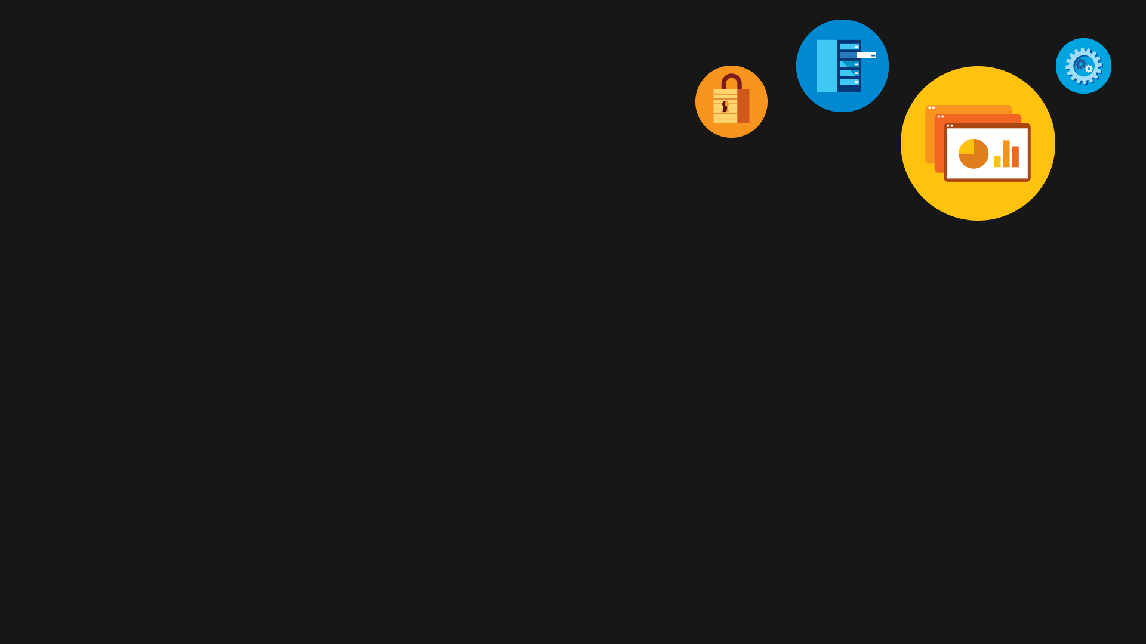
Main takeaways for Azure Functions:
Multiple languages supported
Event Driven Programming
Pay per use pricing model
Scale on demand
Focus only on development

Slide 16
LinkedIn
/in/07piyushvaishya
Email
piyush.vaishya@celebaltech.com

